Slide 1

Marketing Campaign Analysis
ISM 6351
Yayuan Zhang
Notes:
Good morning, everyone. I'm Selina, and today, I invite you to delve into the pivotal realm of modern business: the analysis of marketing campaigns. As we navigate this topic, I will decode the transformative power of campaigns – how they mold consumer behavior, fuel revenue streams, and, critically, shape an organization's financial trajectory.

Slide 2
Business Statement
Business Problem
Optimizing marketing campaign effectiveness to maximize customer engagement and ROI, using market segmentation, predictive modeling, and rigorous statistical validation.
STP Analysis w/K-Means
Segmentation, Targeting (RFM Analysis), PCA. K-Means Clustering
Important of segmenting the market to understand customer behaviors and preferences.
Quantitative Research
A/B Testing – Income group
Two sample t-test: response rate, number of purchasing and spent
ANOVA – Product consumption
Education & Marital Status
Prediction Model
Linear SVM
To predicate who will response the last campaign
Business Statement
Data & Data Prep
EDA
Quantitative research & Models
Ethical & Christian Faith
Notes:
Guiding challenge? To fine-tune the potency of marketing campaigns, ensuring they don't just resonate but also optimize customer engagement and yield tangible ROI. By applying STP and K-Means, I segmented the market and delved deep into the nuances of each segment. my analytical journey was further enriched with A/B testing and ANOVA, paving the way for a predictive model that identifies potential respondents for the last campaign.

Slide 3



Overall Analysis Process
Marketing Campaign Analysis
Read in the Data
Rename
Duplicate values
Data type & Null values
Imputed missing values
Outliers values
Unique values
Missing values
Data Preparation
Merge mapping
Normalization
Add new cols.
Deleted irrelevant features
Zero value analysis
EDA & Viz
Heatmap
Pair Plot
Pie
Histogram
Bar
Scatterplot
Quantitative research
A/B Testing
ANOVA
P-values
T-stat values
Reject / Fail
K-Means Clustering
Segmentation
Targeting (RFM Analysis)
Positining
3D k-means clustering
Linear SVM
80% Train Set
Confusion Metrix
Tweaking parameters
Accuracy: 0.88
Modeling
Business Statement
Data & Data Prep
EDA
Quantitative research & Models
Ethical & Christian Faith
Notes:
Technically speaking, the back/bone of this project was the Python programming language for data reading, preprocessing, analysis and modeling. To bring the data alive visually, tools like PowerBI and Echart integrated with JavaScript were applied. Okay, Let’s start!

Slide 4



Who are the Stakeholders
Marketing Team
Understanding the effectiveness of five different campaigns and identifying insights for future strategies.
Sales Team
They are interested in identifying the most effective campaign results in the highest number of conversions to help them focus efforts on potential high-value customers.
Senior Management
They are concerned with overall ROI and want to identify the most successful marketing campaign that significantly contributes to the organizations’ revenue.
Business Statement
Data & Data Prep
EDA
Quantitative research & Models
Ethical & Christian Faith
Notes:
The project has three main stakeholder groups. The marketing team is interested in which campaign has the highest response and to formulate future strategies. Sales teams look to identify the highest converting campaigns to target prospects, while senior management focuses on identifying the campaigns that will best drive ROI and increase revenue.

Slide 5
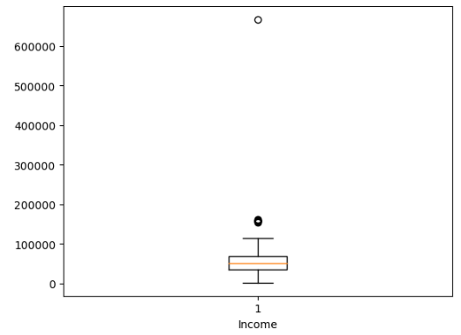
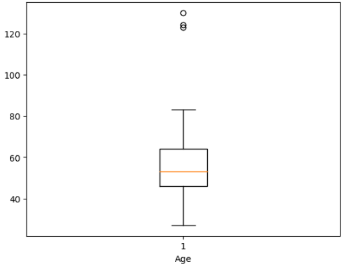
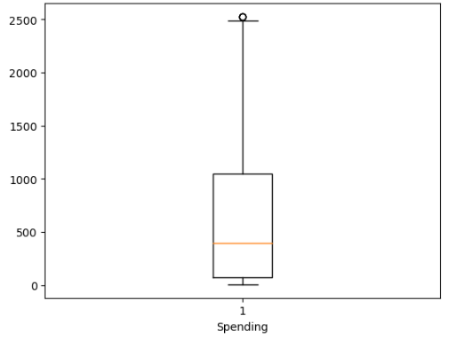
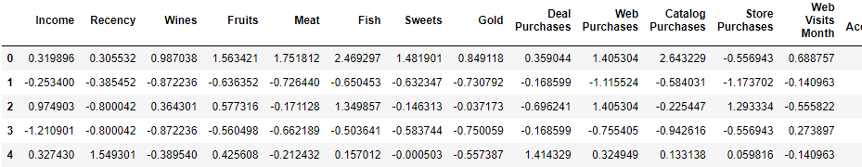
Adding new 4 features
Imputing missing values
Rename
Merge mapping
Handling Outlier
Hot-One Encoder
Z-score Normalization
Drop unnecessary cols
Age
Has Child
Income group
Generation
Spending
Enrollment Year
Enrollment Month
Enrollment Day
Var: Income
24 missing data point
1.07%
Imputing w/ its median values
w/ its median values
Zero value analysis
data.rename(columns={})
28 attributes
Var: Marital Status
8 categories
‘Single’ & ‘Alone’, Single
‘Married’ & ‘Together’, in relationship
‘Absurd’ & ‘Yolo’, deleted
Data Pre-processing (8)
Box Plot
Interquartile Range
Var: Income
Var: Age
Var: Spending
Dummy()
pd.get_dummies(data_k, columns=["Education", "Marital Status"])
StandardScaler()
Excluded cols: binary, dummy cols
Drop irrelevant vars for K-Means
ID
Kids
Teens
Date
Business Statement
Data & Data Prep
EDA
Quantitative research & Models
Ethical & Christian Faith
Notes:
The original dataset was dirty and required extensive cleaning and feature engineering. I spent a significant time in data pre-processing step for further analysis. All visualization, analysis and modeling were based on this cleaned dataset. I undertook 8 key steps. Firstly, I focused on 5 foundational task, introducing four new features, filling missing values for 24 income variables, renaming, merging 8 marital categories into four, and removing outliers from three variables. Subsequently, for model refinement, I used hot one encoding for categorical variables, applied z-score normalization, and dropped unnecessary columns.

Slide 6
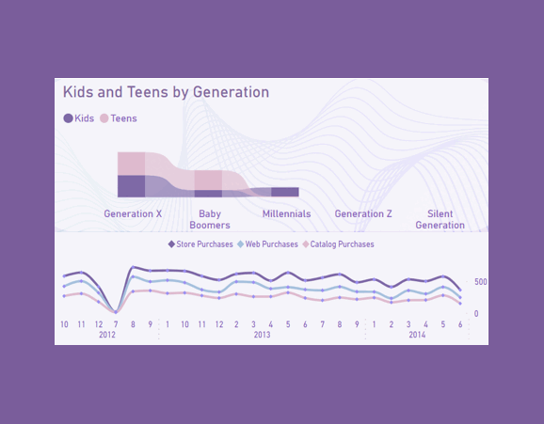
Insight
Campaign Insights:
Campaign 4: Most effective
Campaign 2: Needs refinement
Shopping Trends:
In-store remains dominant
Dip observed in July 2012
Demographics:
Majority in relationships
Bachelor's degree prevalent
Purchase Preferences:
Wines top the list
Elderly favor wines over meats
Gold's Value: Consistent across age groups, except octogenarians
Octogenarian Trend: Shift towards health-centric choices
Kaggle
2240 data points & 29 features
Cleaned data: 2222 data points & 31 features
Each row represents customer basic info: Income, Education, Marital status, have kid or teen, spending amount for items, etc.
6 Campaigns’ response
Business Statement
Data & Data Prep
EDA
Quantitative research & Models
Ethical & Christian Faith
Notes:
The dataset that come from Kaggle has around 2000 data point with 31 features in cleaned dataset.
I identified key insights into customer behaviors. Campaign 4 significantly outperforms others, indicating its resonance with our audience, while Campaign 2 lags, highlighting areas for strategic refinement. A striking observation is that regardless of the digital era, in-store shopping reigns supreme, though a dip in July 2012 hints at external influences on purchasing patterns. Our demographic predominantly consists of individuals in relationships, with a bachelor's degree influencing buying behaviors. Notably, wines are a standout in purchase preferences across age groups, with a distinct shift observed in the elderly favoring wines over meats. Meanwhile, the value of Gold remains consistent, but the octogenarian bracket showcases a preference for health-centric choices.

Slide 7
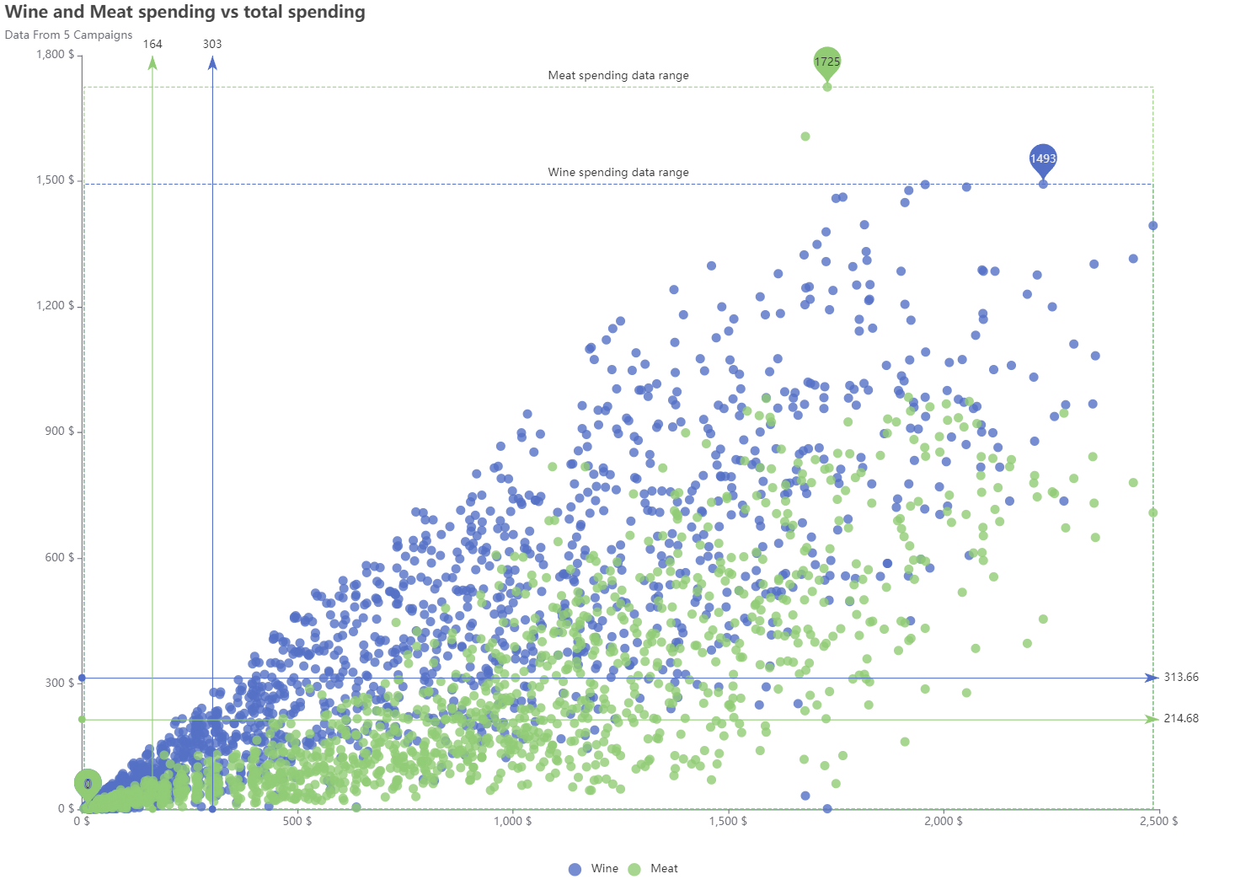
Scatter Plot: Wine spending vs. Meat vs. Total spending
The range of expenditures on meat is more extensive than meat, covering both minimal and significantly high costs.
Wine tends to have a higher average expenditure than meat.
Meat spending fluctuates; wine, a specialized product, attracts higher average investments.
Silent Generation and Baby Boomers often show higher spending. Their accumulated wealth and sophisticated tastes make them key players in the wine industry
Business Statement
Data & Data Prep
EDA
Quantitative research & Models
Ethical & Christian Faith
Notes:
In a scatter plot comparing wine and meat spending, meat has a wider expenditure range due to its dietary role, while wine, often seen as a luxury, attracts higher average costs. Older generations, with their wealth and tastes, likely boost this wine expenditure.

Slide 8
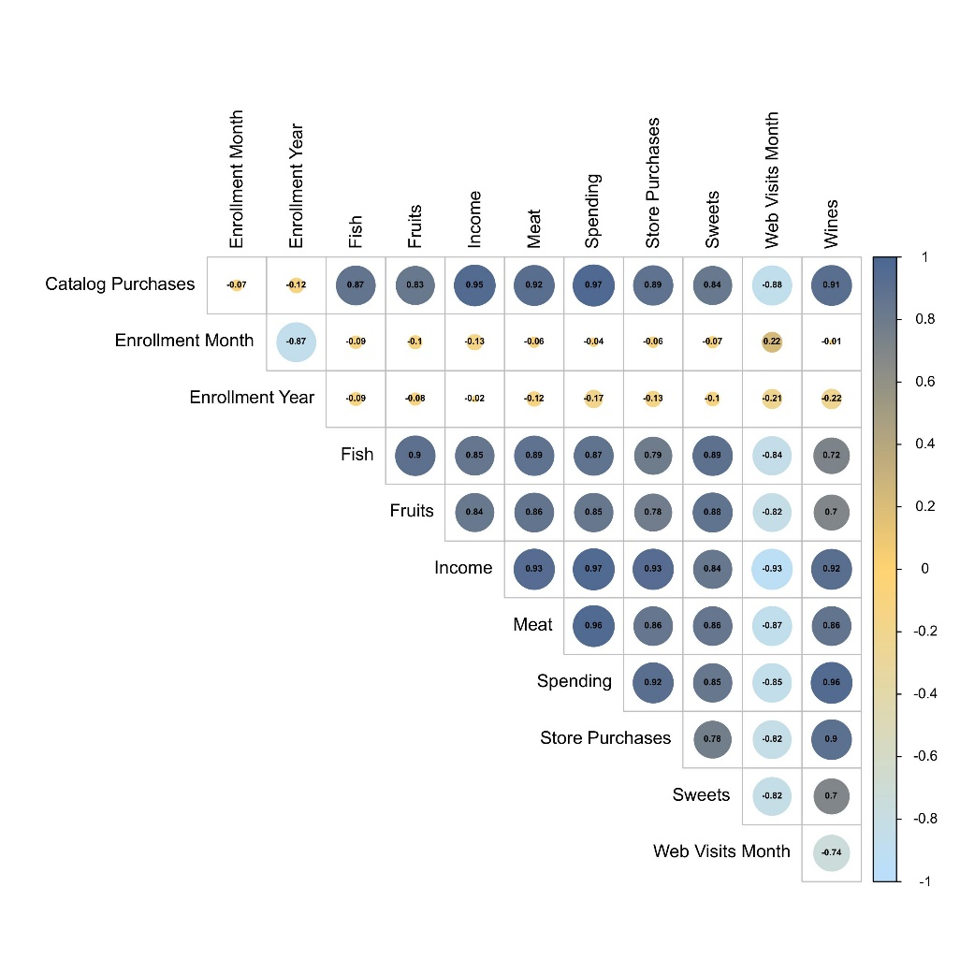
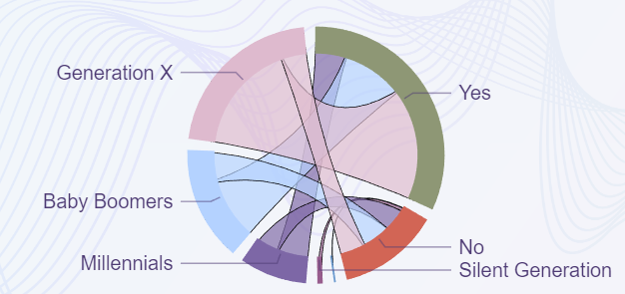
Generation Chord Plot High Correlation Heatmap
Customers with longer employment tenure have lower total balance and credit risk
Strong family presence in our customer base - 72% of customer from various generation have at least one child.
Family-centered marketing approach is important
0.6
strong variable interconnections
Strong correlations
Business Statement
Data & Data Prep
EDA
Quantitative research & Models
Ethical & Christian Faith
Notes:
The chord plot shows 72% of customers from various generations have at least one child, emphasizing the strong family presence in our customer base. This data suggests a family-centered marketing approach is crucial for increased engagement and conversion rates.

Slide 9
A/B Testing
Top-performing: Campaign 4
High Income Group
Low Income Group
95% significance level
Customer Acceptance
Number of Purchases
Amount Spent
T statistic: 6.84
T statistic: 32.65
T statistic: 28.92
P value: 1.35e-11
P value: 2.48e-161
P value: 2.92e-135
Reject the Null Hypothesis
Reject the Null Hypothesis
Reject the Null Hypothesis
Significant Difference
Significant Difference
Significant Difference
Diversify Marketing Strategy
Monitor Purchasing Behaviors among various income groups
Business Statement
Data & Data Prep
EDA
Quantitative research & Models
Ethical & Christian Faith
Notes:
Through advanced quantitative methods, including three A/B testings and two ANOVA analyses, I gain deeper insights into consumer behavior. In the ab test, I used a 95% significance level to compare the difference between the high-income group and the low-income group. I found that income level greatly determines response rates, frequency of purchasing, and spending patterns in the top performing campaign, which is 4. These three tests hold high t statistics values, indicating a significant difference in average number of response, purchases and spending between the two groups. The business might create diversify marketing strategies to cater to distinct income level, and Monitor purchasing behaviors among various income groups to detect changing trends as well.

Slide 10
ANOVA
95%
Average price of purchases products
Fish
Meat
Fruits
Sweet
Wines
Gold
Marital Status
Education
Fail to Reject the Null Hypothesis
Reject the Null Hypothesis
No Significant Difference
Significant Difference
Different marital statues levels show same consumption patterns.
Different education levels show varied consumption patterns.
Personalized Marketing
Collaborations and Partnerships
Business Statement
Data & Data Prep
EDA
Quantitative research & Models
Ethical & Christian Faith
Notes:
The ANOVA also uses a 95% significance level to determine whether marital status or education affects consumption of various products. The results show that marital status does not have a significant effect on product consumption, but education level does, so it would be leading to consider partnerships with academic institutions.

Slide 11
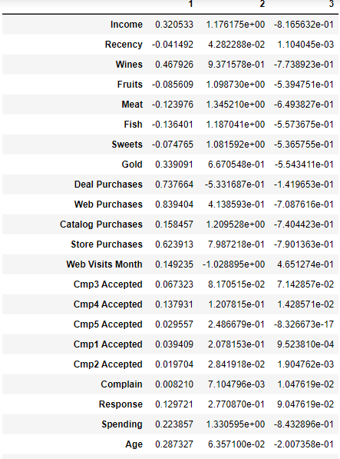
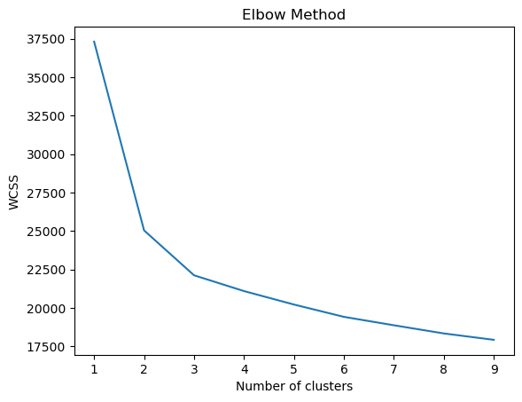
K-Means: STP Analysis
Cluster 1
Balanced Shoppers
Middle-ground cluster with moderate behavior across the board.
Demographics: This group leans towards people with graduation education and those in a relationship.
Purchase Types: Higher values in wines, deal purchases, web purchases, store purchases indicating a preference for these categories.
609
Cluster 2
Affluent Diverse Shoppers
High-earning and high-spending group, displaying affluent behaviors and diverse shopping tastes.
Demographics: High proportion of individuals with children and higher education.
Purchase Types: High values across multiple categories like wines, fruits, meat, fish, sweets, catalog purchases indicate a diverse purchasing behavior..
Based on centroids
563
Cluster 3
Conservative Online Enthusiasts
Low spending and income but shows higher web activity, indicating a potential for online campaigns and promotions.
They visit the web most frequently among all clusters.
Demographics: Mixed bag in terms of education but higher proportion of singles.
Purchase Types: Generally low values across purchase categories.
K=3
1050
Segmentation
Targeting
Positioning - PCA
Notes:
I applied a combination of K-means and STP analysis to segment the broad market into three distinct customer groups, with the Elbow Method determining k = 3 as optimal. These clusters are
Group 1, This segment represents moderate ear/ners and spenders who engage at an average rate. They have a pronounced inclination for wines and online shopping and are ty/pically well-educated individuals in relationships.
Cluster 2 - "A/fflu/ent Dai/verse Shoppers": Standing out with the highest income and expenditure, this segment is chara/cterized by its varied shopping patterns and strong responsiveness to multiple campaigns. A significant portion of this group comprises highly-educated individuals with children.
Cluster 3 - "Conservative Online shoppers": Even though this group represents the lower range of spending and income, their heigh/ten/ed online activity de/notes a prime opportunity for digital campaigns. Notably, This group of people accounted for the largest number of people in the case. And singles form the mai/jority here.
Each segment offers unique marketing opportunities to target.
Cluster 1:
Income & Spending: Moderate income and spending. This group is probably the middle-income earners.
Recency: Average recent interactions.
Purchase Types: Higher values in wines, deal purchases, web purchases, store purchases indicating a preference for these categories.
Web Visits: They visit the web moderately.
Campaign Responses: Moderate acceptance rates to various campaigns.
Demographics: This group leans towards people with graduation education and those in a relationship.
Cluster 2:
Income & Spending: Highest income and spending among all groups. This group likely represents the high-income earners.
Recency: Slightly more recent interactions than Cluster 1.
Purchase Types: High values across multiple categories like wines, fruits, meat, fish, sweets, catalog purchases indicate a diverse purchasing behavior.
Web Visits: They visit the web least frequently.
Campaign Responses: Higher acceptance rates for multiple campaigns.
Demographics: High proportion of individuals with children and higher education (Graduation, Master, PhD).
Cluster 3:
Income & Spending: Lowest income and spending, indicating this group might be the low-income earners or more conservative spenders.
Recency: They've recently interacted slightly more than Cluster 1 but significantly less than Cluster 2.
Purchase Types: Generally low values across purchase categories.
Web Visits: They visit the web most frequently among all clusters.
Campaign Responses: Moderate acceptance rates, but less enthusiastic than Cluster 2.
Demographics: Mixed bag in terms of education but higher proportion of singles.
Observations:
Cluster 1 seems to be the middle-ground cluster with moderate behavior across the board. They could be termed as "Balanced Shoppers".
Cluster 2 is the high-earning and high-spending group, displaying affluent behaviors and diverse shopping tastes. They could be termed as "Affluent Diverse Shoppers".
Cluster 3 has low spending and income but shows higher web activity, indicating a potential for online campaigns and promotions. They could be termed as "Conservative Online Enthusiasts".

Slide 12
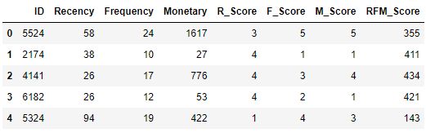
K-Means: STP Analysis
RFM = R + F + M
Recency
Last purchases
Frequency
Deal Purchases + Catalog Purchases + Store Purchases + Web Visits Month
Monetary
Spending of product purchases: fish, fruits, sweets, gold, meat, wine
Premium Customer
RFM score of '555' or '545’. Highly loyal customer
Dormant Customer
RFM score of ‘111' or ‘121’.
Customer Relationship Management
Customer Relationship Management
Exclusive Events & Promotion
Re-engagement Events
Segmentation
Targeting – RFM Analysis
Positioning - PCA
Notes:
In the RFM analysis, customers with a score of 555 or 545 are the premium customers, indicating they have recently made purchases, buy frequently, and spend a significant amount.
To cater to them, businesses should build a good relationship, launching higher-end products and provide personalized services.
like focusing on CRM by assigning personal relationship managers.
Hosting events and offering premium promotions to foster loyalty.
And offer value added service to enhance their experience.
However, I also identified a segment of concern - the dormant customers with a score of '111' or ‘121’.
The Dormant segment represents a goldmine of potential opportunities.
Business needs to survey them to understand the root cause of their dormancy and organize re-engagement events to reintroduce the brand's value proposition. It is important to solve their concerns actively ensuring they feel valued and heard.

Slide 13
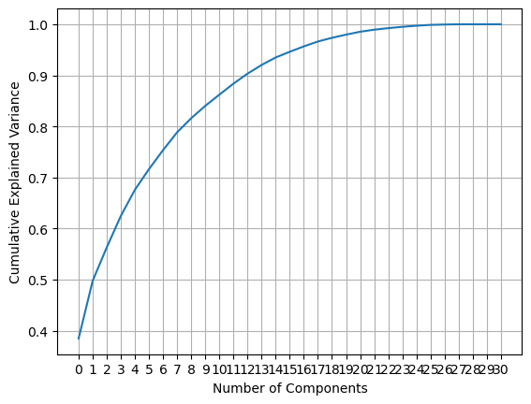
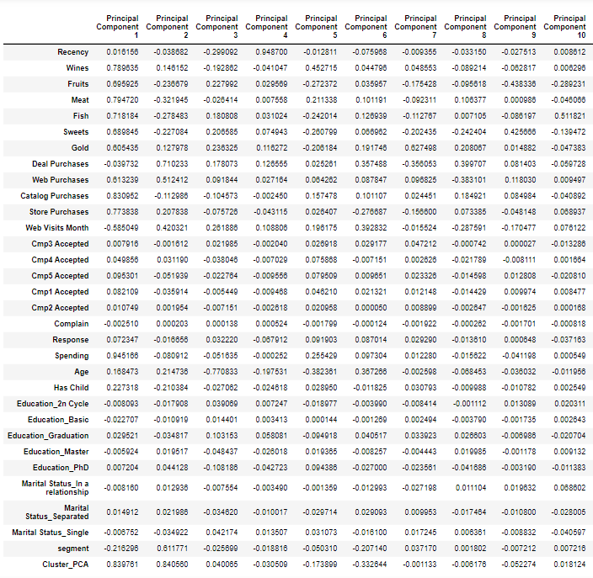
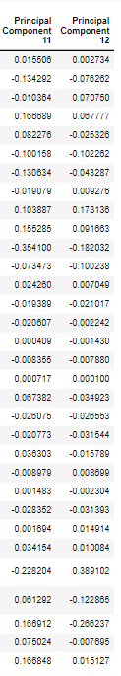
K-Means: STP Analysis
12 principal components
Cumulative Explained Variance – 90%
PC 1
Negative loading with ‘Web purchase’. Higher spending does not necessarily relate to more frequent web visits.
PC 2
It has significant loadings with Deal Purchases and Web Purchases. Purchasing through digital platforms.
PC 3
Significantly negatively loads with 'Age', meaning this group might capture the age effect, with older people having a higher negative score.
PC 4
Largest loading here is 'Recency', which refers to how recently the customer has made a purchase. Recency of purchase behavior.
PC 5
Primarily loads with product categories (Wines, Fruits, Meat, Fish, Sweets, Gold) but in varying directions. Specific spending preferences.
PC 6
Notably loads with Gold, indicating a preference or tendency to purchase gold or luxury items.
PC 7
Loads positively with Web Visits Month, possibly capturing online engagement behavior.
PC 8
Significant positive loadings with Deal Purchases, but negative with Web Purchases. A trade-off between the two purchasing platforms.
PC 9
It seems to contrast the purchasing behavior between Sweets (positive loading) and Fruits (negative loading).
PC10
Highest loading is with Fish. A specific preference in this category.
PC11
Marital Status seems to be the focus here, particularly contrasting "Single" and "In a relationship".
PC12
Marital status is important in this component as well, especially contrasting "In a relationship" and "Single".
Segmentation
Targeting – RFM Analysis
Positioning - PCA
Notes:
By using PCA, I reduced the data to 12 main dimensions, choosing 90% Qmulative explained variance. Because it not only helps me retain most of the meaningful info in the data. Also, 90% is a widely accepted standard because it often offers a good trade-off between these considerations. The results suggest that PC2 captures digital platform purchases, it highlights a shift towards online shopping. PC9 contrasts preferences, where we see differences in buying behavior between sweets and f/rui/ts. PC6 showcases a specific preference towards luxury items, like gold. PC4 highlights the recency of purchase, indicating how recent customers have engaged. In the PCA step, these components help in capturing the main variations and help to build marketing strategic.
Principal Component 1 (PC1):
It primarily loads positively with spending on Wines, Fruits, Meat, Fish, Sweets, Gold, Web Purchases, Catalog Purchases, Store Purchases, and the total Spending, indicating it represents a general spending tendency across these categories. The negative loading with 'Web Visits Month' implies that higher spending does not necessarily relate to more frequent web visits.
Principal Component 2 (PC2):
It has significant loadings with Deal Purchases and Web Purchases. This suggests this component represents purchasing through digital platforms.
Principal Component 3 (PC3):
This component significantly negatively loads with 'Age', meaning this component might capture the age effect, with older people having a higher negative score.
Principal Component 4 (PC4):
The largest loading here is 'Recency', which refers to how recently the customer has made a purchase. This component is representing the recency of purchase behavior.
Principal Component 5 (PC5):
It primarily loads with product categories (Wines, Fruits, Meat, Fish, Sweets, Gold) but in varying directions. This might be capturing specific spending preferences or patterns in certain categories.
Principal Component 6 (PC6):
Notably loads with Gold, indicating a preference or tendency to purchase gold or luxury items.
Principal Component 7 (PC7):
Loads positively with Web Visits Month, possibly capturing online engagement behavior.
Principal Component 8 (PC8):
It has significant positive loadings with Deal Purchases, but negative with Web Purchases. This might represent a trade-off between the two purchasing platforms.
Principal Component 9 (PC9):
It seems to contrast the purchasing behavior between Sweets (positive loading) and Fruits (negative loading).
Principal Component 10 (PC10):
Highest loading is with Fish, representing a specific preference in this category.
Principal Component 11 (PC11):
Marital Status seems to be the focus here, particularly contrasting "Single" and "In a relationship".
Principal Component 12 (PC12):
Marital status seems to be important in this component as well, especially contrasting "In a relationship" and "Single".
In STP (Segmentation, Targeting, and Positioning) analysis, after PCA, these principal components would typically be used to segment the customers based on the new derived variables (PCs). The PCs reduce the dimensionality and capture the primary variance in the dataset. After segmentation, specific segments would be targeted for marketing or other strategic initiatives, and the positioning would be determined based on the characteristics of those segments and the PCs that define them.

Slide 14
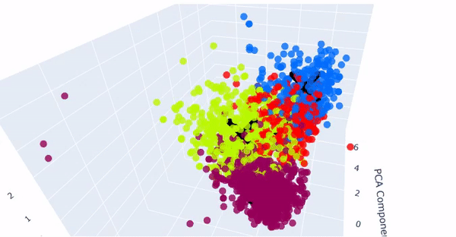
K-Means: 3D Clustering
Average Silhouette Score
0.29
Well Separated
Effectively identified distinct groups
Relatively Homogeneous
Unique behaviors & Preferences
Business Statement
Data & Data Prep
EDA
Quantitative research & Models
Ethical & Christian Faith
Notes:
When look at the 3D k-means clustering, the separate clusters highlight the distinct characteristics of each group, and relatively homogeneous. While the silhouette score of 0.29 is acceptable, it indicates potential improvement areas.
I recommend developing marketing strategies for each customer cluster based on their unique needs and preferences, it allows us to effectively reach and engage these customers.

Slide 15
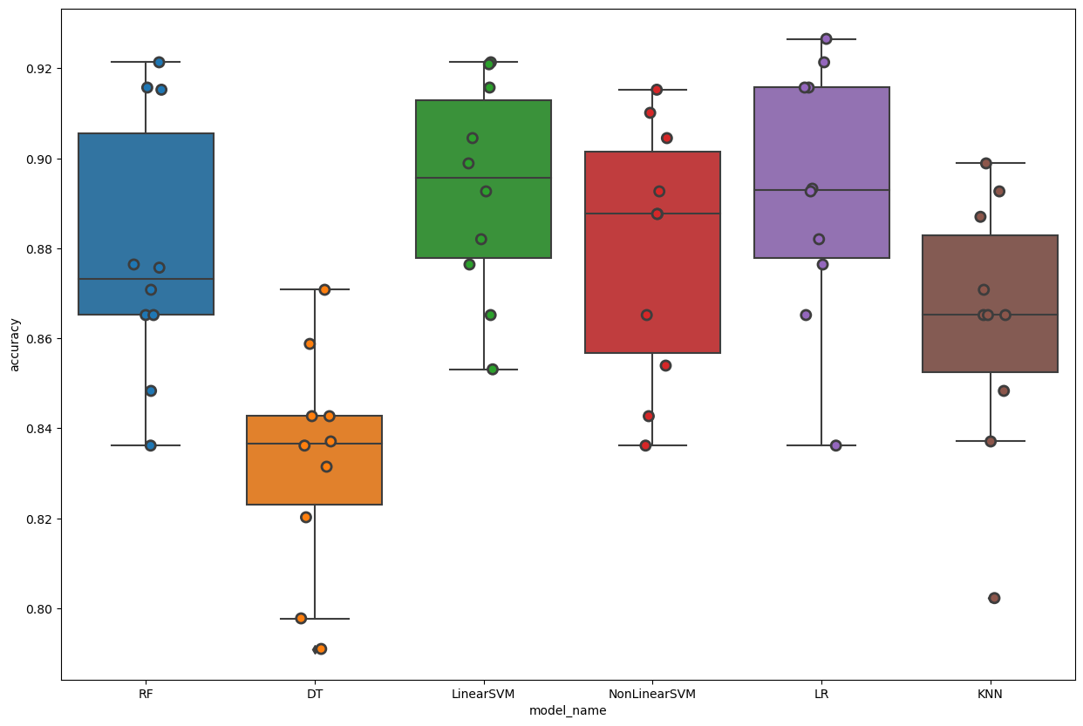
Prediction Model – last campaign
Linear SVM
K-fold
Average accuracy
Tweaking parameters
RandomizedSearchCV()
Train set (After tweaking) – classification report
Accuracy
0.93
Recall
1.00
F1 Score
0.97
Support
1512
Test set (After tweaking) – classification report
Confusion Matrix
377 | 3
51 | 14
Support
380
Accuracy
0.88
Recall
0.99
F1 Score
0.93
Business Statement
Data & Data Prep
EDA
Quantitative research & Models
Ethical & Christian Faith
Notes:
Lastly, after testing 6 models, I selected the Linear SVM model with the highest accuracy to predict who will respond to the last marketing campaign. After feature engineering and tweaking parameters, I achieved an accuracy of 88% without overfitting issues.

Slide 16
Business Problems
Optimize future strategies
Customer segmentation
CRM – Premium & Dormant customer
Overall ROI
Predictive model
Thank you
Questions?
References
https://www.kaggle.com/datasets/pavansubhasht/ibm-hr-analytics-attrition-dataset
Notes:
Through this project, I solved the following business problems
pivotal business problem of identifying the most effective marketing campaigns to optimize future strategies, . By enhancing customer segmentation, I identified distinct customer groups, understanding both our premium clientele and more dormant segments. Recognizing the factors influencing their spending to better-targeted marketing strategies, improving the overall ROI for senior management. Moreover, with a predictive model in hand, the business can predict which customers are likely to respond to similar campaigns in the future.

Slide 17

Ethical Implications and Christian Faith
Privacy Concerns
Data Transparency
Christian Faith: As DA, potential ethical implications of the work and to act in a way that upholds Christian values of dignity, respect, privacy, and justice
"Speak up for those who cannot speak for themselves, for the rights of all who are destitute. Speak up and judge fairly; defend the rights of the poor and needy." - Proverbs 31:8-9
Notes:
The dataset contains sensitive customer information, including demographic and financial-related information. These data need to be protected and prevent data breaches. As data analytics, it is important to ensure that data is used ethically and for the intended purpose, and also, it is important to ensure that individuals whose data are included in the dataset have provided informed consent to how their data will be used with respect.
Additionally, ensuring transparency of the algorithms used in the data analysis process is important. This includes being transparent about the sources of data and the methods used to analyze the data and being accountable for any decisions made based on the analysis.
At the end, As DA, potential ethical implications of the work and to act in a way that upholds Christian values of dignity, respect, privacy, and justice.

Slide 18

Challenges
Big dataset
Dirty dataset
Multiple dimensions
Run slow
Thank you
Questions?
References
https://www.kaggle.com/datasets/pavansubhasht/ibm-hr-analytics-attrition-dataset
Notes:
We also facing some challenges when doing the process
In this case, there are too many rows in the majority class (paying the loan on time) and less rows in the minority class (not paying the loan on time).
This shows that this is a highly unbalanced dataset, with the minority class accounting for only about 8.1% of the majority class. To deal with this unbalanced dataset, you can try using a threshold below 0.5 and we set to 0.3, which will increase the probability of classifying the sample as a minority class.
Limitations: The dataset contains a large number of features, and some of them may not be useful for predicting loan defaults. It is also a very large dataset and the training data connected to other external sources and we need left join multiple datasets, we also faced couple R session crashing due to this, so in this case we removed all the external source variables to finish the project easier. In the future, it may be beneficial to re-run the project with the complete datasets to develop more accurate prediction models.

Slide 19
Thank you for watching!

